Slide 1
Smart parking using machine learning
Presented by:
Rajiv Iyer
Sree Ganesha Chellappa
Navin Subbu
Muthu Sumathy Thevar
Under Guidance of
Prof. Hema Raut

Slide 2
Presentation structure :
Project Introduction - (Demo owner: Sumathy)
License Plate Detection (LPD) - (Demo owner: Navin)
Parking Lot Occupancy management module(SmartparkApp) - (Demo owner: Rajiv)
Google Firebase Database and Storage - (Demo owner: Rajiv/Navin)
Smartpark Web App - (Demo owner: Sri Ganesha)

Slide 3
Introduction
In a country where it took 60 years to acquire 100 million vehicles but added another 100 million in just the next ten years, free and illegal parking has become both a serious urban planning and public health issue.
The system makes use of live feed from CCTV cameras
Detection of number plate of the car is done
License Plate Detection (LPD) system plays an important role in many applications like electronic payment system like toll payment and parking fee payment.
In this project recognition of the license plate is done, time stamping them and carry out the prediction of their entry and exit time and a database is created. On exiting, the same are validated.
During setup of the system, the total available parking spots can be configured as Members and Outsiders/Visitors only spots.
The parking spaces will consist of UDM sensors linked to NodeMcu/ESP32 Wi-Fi board that detects the presence of car parked. This will give a confirmation that the car has been parked successfully in that parking lot. When the car is moved back from the space, the slot is retained back in the system.

Slide 4
LITERATURE SURVEY

Slide 5
PROPOSED SYSTEM
In this proposed system,main purpose is to build a parking system to save time and to increase security.
Our parking system has an organized way of allotting residents/employees a permanent parking space.
People waste time in finding parking spots to park their car so we can create a system efficient enough to overcome this time barrier.
When the car enters the parking area the camera detects the number plate noting the time of entry. There will be a database consisting of details of the car owner if he is a resident/employee. If an outsider wants to park the car, the system will check for free outsider designated parking spaces.
By using Time Stamping we will be able to assign a resident’s/employee’s spot to a visitor/outsider if he/she arrives on out of bounds time. We can increase security by using Time Stamping.

Slide 6
METHODOLOGY
The project aims to take all the efficient aspects of the projects proposed in the literature survey and integrate it with an efficient feedback to be part of a solution for the parking problem.
To understand the properties of NodeMCU ESP 8266 module
To understand the basic python functions.
To create a database using Google firebase.

Slide 7
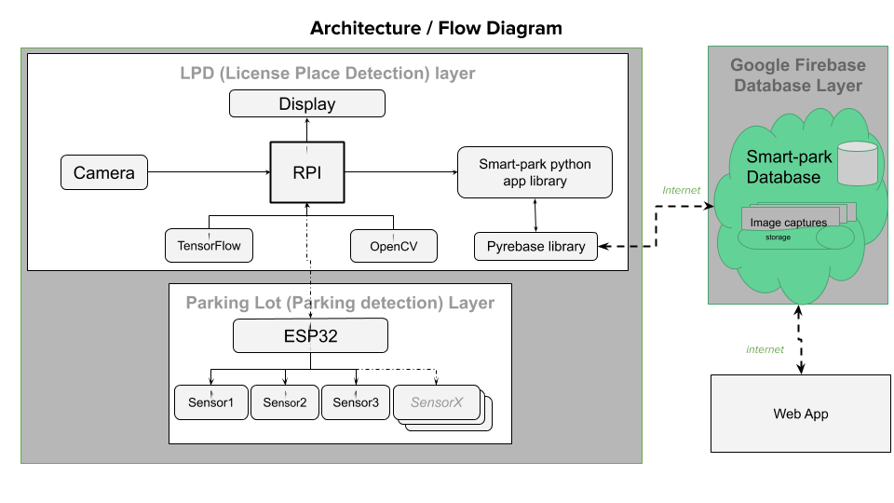
FLOW DIAGRAM

Slide 8
HARDWARE AND SOFTWARE REQUIREMENTS
Hardware Components:-
Raspberry Pi Camera
Raspberry Pi
Ultrasonic distance measure
NodeMCU ESP 8266
Software Tools:-
Anaconda Navigator
Python and it’s modules
Visual Studio Code
Tensorflow
Arduino Ide

Slide 9
System implementation
System consists of following process :-
License Plate Detection Using Tensorflow and OpenCV
Image segmentation and Optical Character Recognition (OCR)
Firebase Realtime Database and Storage
Parking Lot Management System (Smart Parking)

Slide 10
License Plate Detection Using Tensorflow and OpenCV
Using Tensorflow we trained a custom object detection model for detecting the object, in this case the license plate of a car and capture an image
The hardware requirement for this is not much, most of the modern computers with a decent GPU will perform well.
OpenCV is used to stream a live video from the video camera installed on the boom barrier at the entrance.
The video captured is processed through the trained model, detection algorithms find the most probable locations of objects and draw bounding boxes.
If the object is found, the bounding box that shows the objects passes the coordinates and the score which are then displayed in green on the live video.
When the score of the detected object is greater than the desired value, an image is captured with the timestamp of when it was captured and stored in a local storage.

Slide 11
Image segmentation and Optical Character Recognition (OCR)
The license plate was detected from the live feed and the frame of the video has been captured.
The image is the processed for increasing the accuracy of OCR.
The image is resized and converted to grey scale image.
It is then processed through bilateral filtering.
Edge detection is performed to detect the edge of the license plate.
Contouring is to extract the contour with the license plate.
Then masking is performed to isolate the contour and the cropped.
The cropped frame is then processed for OCR.
Optical character recognition in Python is done with the help of Google’s Tesseract Library.

Slide 12
Firebase Realtime Database and Storage
Google firebase is an online real-time database management system.
The feature is used to store the license plate number and the snapshot of the car from the front when it was detected.
When the license plate is detected and processed through OCR, the text string is passed as a license parameter along with image of the car and current timestamp to smartparkapp.py module and is pushed to firebase.
Simultaneously, the image captured is saved in the firebase storage for future references.

Slide 13
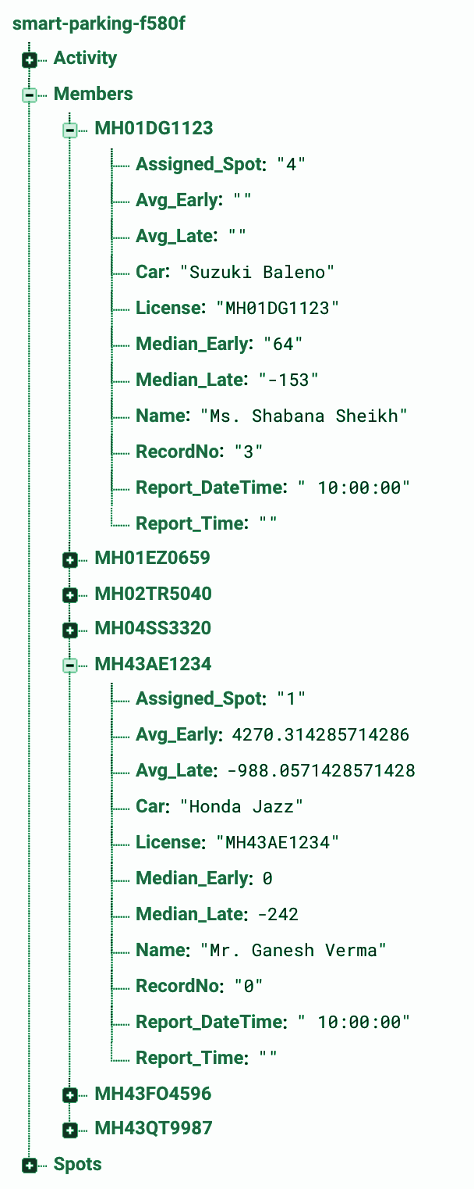
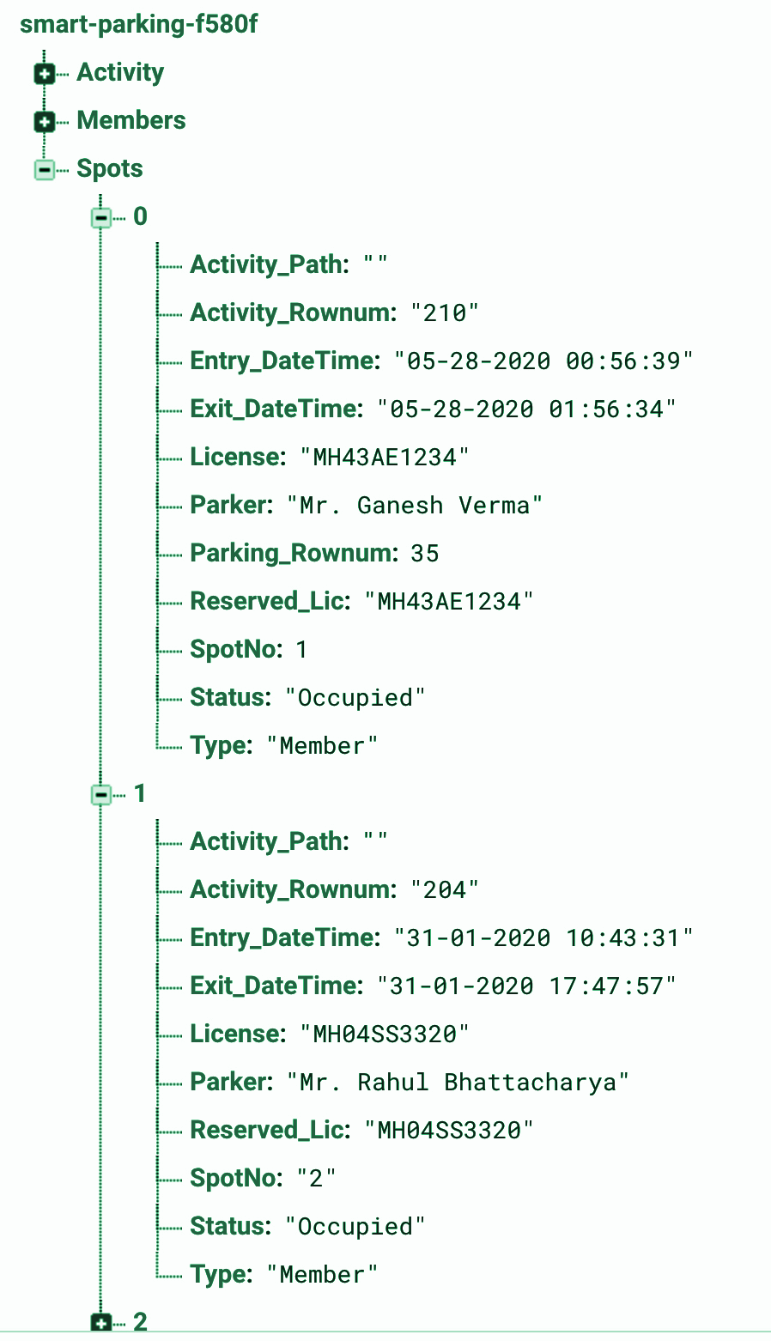
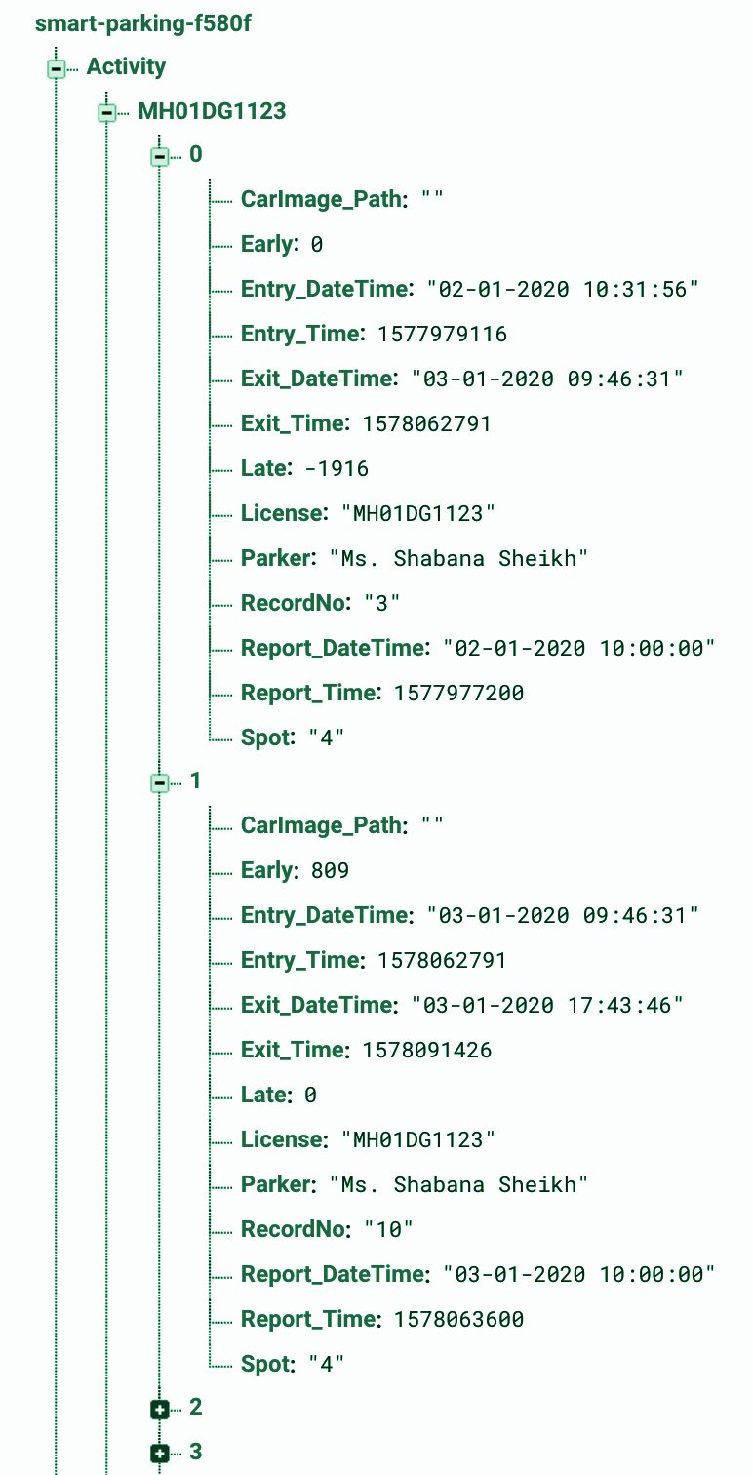
Google Firebase Database and Storage - (Demo owner: Rajiv/Navin)
Smartpark database schema
(https://smartpark-914f1.firebaseio.com/)
Members
Spots
Activity

Slide 14
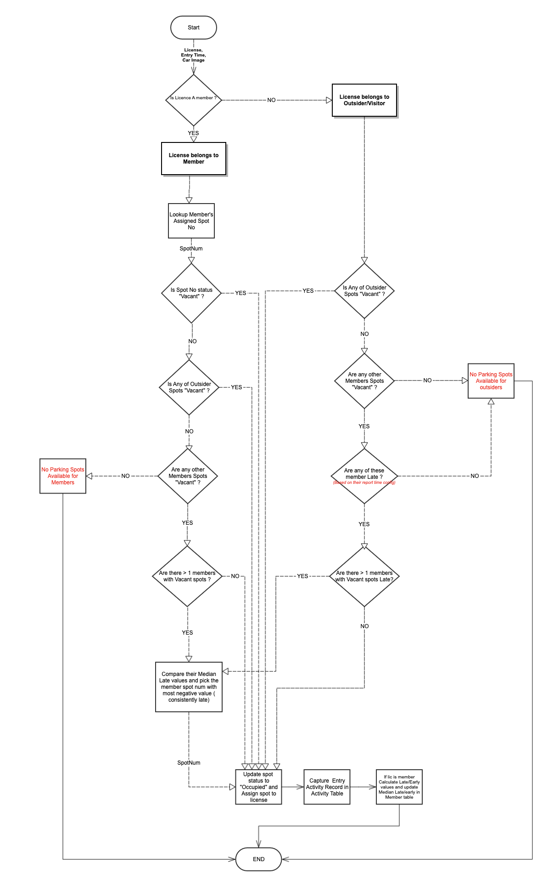
Parking Lot Occupancy management module(SmartparkApp) - (Demo owner: Rajiv)
Some Key lot management requirements:
Every member is pre-allotted a spot and gets the spot if its vacant on entry.
Every member has a reporting time indicating expected arrival time.
There are pre-designated spots for outsiders and outsiders are alloted that spot on entry
If all outsider spots are occupied then outsiders get member spots provided that member is not close to his/her reporting time (apply late arrival criteria)
If all member spots are occupied then members are alloted outsider spots provided they are vacant.
If a member enters and his allotted spot and all outsiders are occupied then he is alloted another member’s spot. The choice of this other member is based on a ‘smart’ criteria (apply member late median criteria)
https://go.gliffy.com/go/publish/13366394

Slide 15
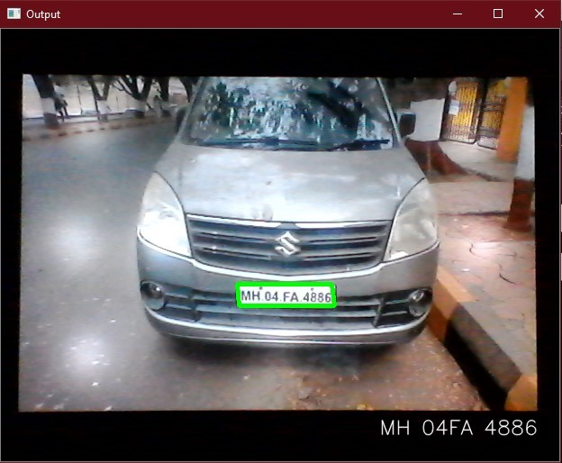
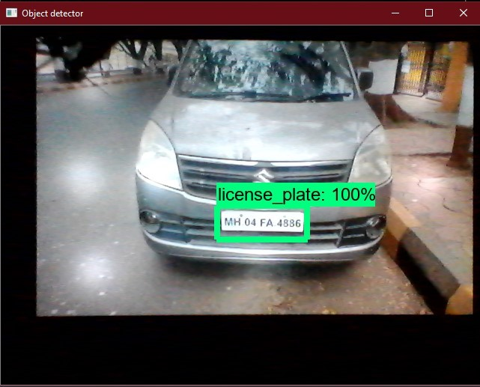
RESULTS
Object Detection Output

Slide 16
DEMO Usecase1: Navin

Slide 17


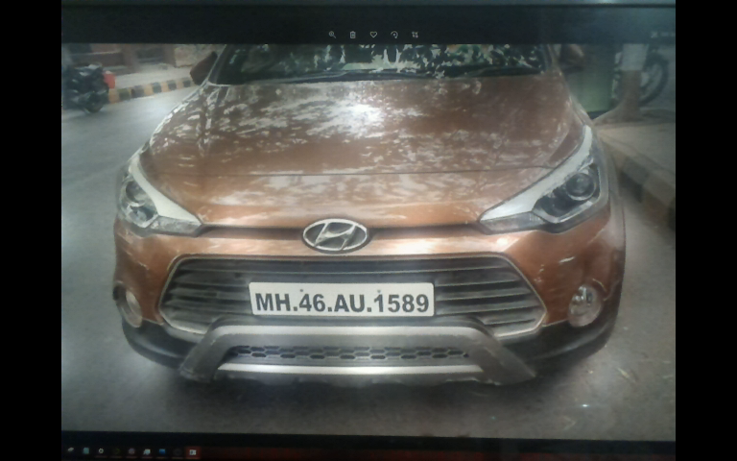
Demo use case 1 : LPD
Member spot
Outsider spot
State 0: Empty parking lot. 7 are Member spots. 3 are Outsider spots.
Member Car
Ganesh
Rahul
Lakshmi
Shabana
Justin
Rakesh
Sheela
Outsider
Outsider
Outsider
Outsider Car
1
2
3
4
5
6
7
8
9
10
State 1: LPD detects Shabana’s car License MH46AU1689 via camera, ML and OCR. Calls smartapp method RegisterCarEntry() with license Num. Smartapp recognizes Shabana as a member based on her license registered in the member tables and allots her Spot 4 which is pre-allocated to her. .
A Spot is allocated to Shabana. Shabana’s car image should be captured in storage:
Ganesh
Rahul
Lakshmi
Shabana
Justin
Rakesh
Sheela
Outsider
Outsider
Outsider
1
2
3
4
5
6
7
8
9
10
State 2: LPD detects Shabana’s car License MH46AU1689 via camera, ML and OCR. Calls IsCarParked() and then calls RegisterCarExit(). Shabana exits and vacates spot 4.
Ganesh
Rahul
Lakshmi
Shabana
Justin
Rakesh
Sheela
Outsider
Outsider
Outsider
1
2
3
4
5
6
7
8
9
10

Slide 18
DEMO Usecase 2: Rajiv

Slide 19
Use case 2 : Complex parking scenario (1/3)
Member spot
Outsider spot
State 0: Empty parking lot. 7 are Member spots. 3 are Outsider spots.
Member Car
Outsider Car
Ganesh
Rahul
Lakshmi
Shabana
Justin
Rakesh
Sheela
Outsider
Outsider
Outsider
1
2
3
4
5
6
7
8
9
10
State 1: 4 member cars enter.
Ganesh
Rahul
Lakshmi
Shabana
Justin
Rakesh
Sheela
Outsider
Outsider
Outsider
1
2
3
4
5
6
7
8
9
10
State 2: 3 Outsider cars enter.
Ganesh
Rahul
Lakshmi
Shabana
Justin
Rakesh
Sheela
Outsider
Outsider
Outsider
1
2
3
4
5
6
7
8
9
10

Slide 20

Use case 2 : Complex parking scenario (2/3)
Member spot
Outsider spot
Member Car
Outsider Car
State 3: 4th outsider arrives at 10:30. Outsider is allocated Sheela’s spot because of her median score.
Ganesh
Rahul
Lakshmi
Shabana
Justin
Rakesh
Sheela
Outsider
Outsider
Outsider
Late arrival Median values
Justin | Rakesh | Sheela
-492 | 0 | -769
1
2
3
4
5
6
7
8
9
10
State 4: 5th member Sheela whose spot has been occupied by outsider enters. She is allocated Justin spot.
Ganesh
Rahul
Lakshmi
Shabana
Justin
Rakesh
Sheela
Outsider
Outsider
Outsider
Late arrival Median values
Justin | Rakesh
-492 | 0
1
2
3
4
5
6
7
8
9
10
State 5: 3 Rakesh Arrives and occupies his own spot. All spots are now taken and parking lot is full
Ganesh
Rahul
Lakshmi
Shabana
Justin
Rakesh
Sheela
Outsider
Outsider
Outsider
1
2
3
4
5
6
7
8
9
10
State 6: Justin, A member arrives is denied entry as lot is full. An outsider then arrives and he is denied entry as well.
Justin
Outsider

Slide 21
Use case 2 : Complex parking scenario (3/3)
Member spot
Outsider spot
Member Car
Outsider Car
State 7: The 8th spot outsider exits. 8th spot becomes vacant.
Ganesh
Rahul
Lakshmi
Shabana
Justin
Rakesh
Sheela
Outsider
Outsider
Outsider
1
2
3
4
5
6
7
8
9
10
State 8: Member Justin now attempts to enter again. He will be allotted the recently vacated outsider spot 8.
Ganesh
Rahul
Lakshmi
Shabana
Justin
Rakesh
Sheela
Justin
Outsider
Outsider
1
2
3
4
5
6
7
8
9
10

Slide 22
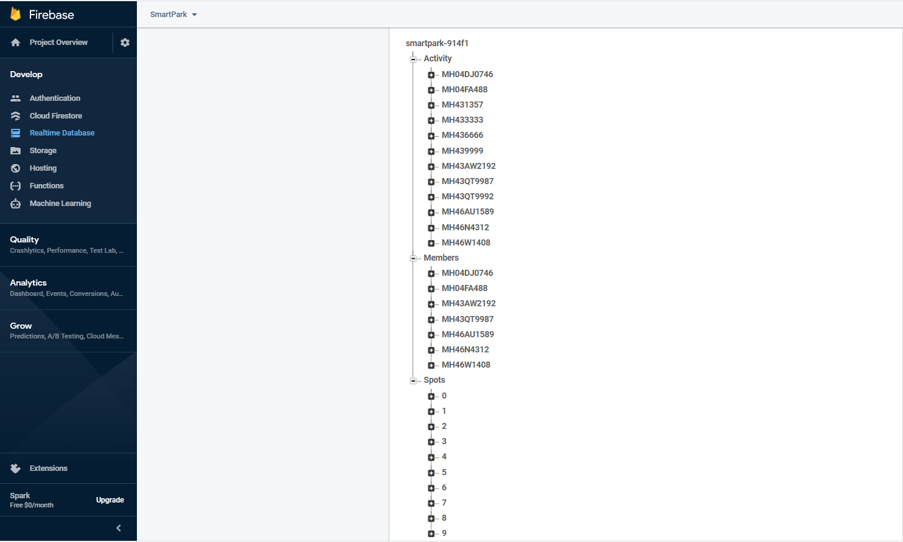
RealTime Database

Slide 23


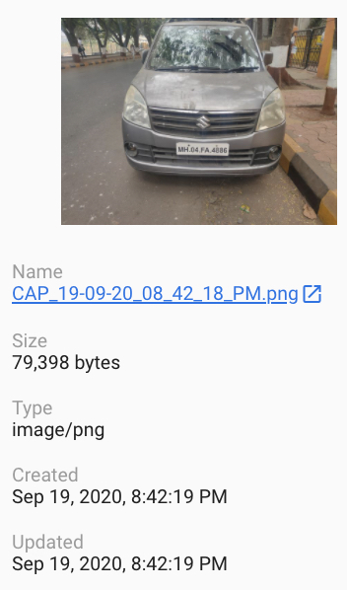



Google Firebase Storage : Image capture hierarchy

Slide 24
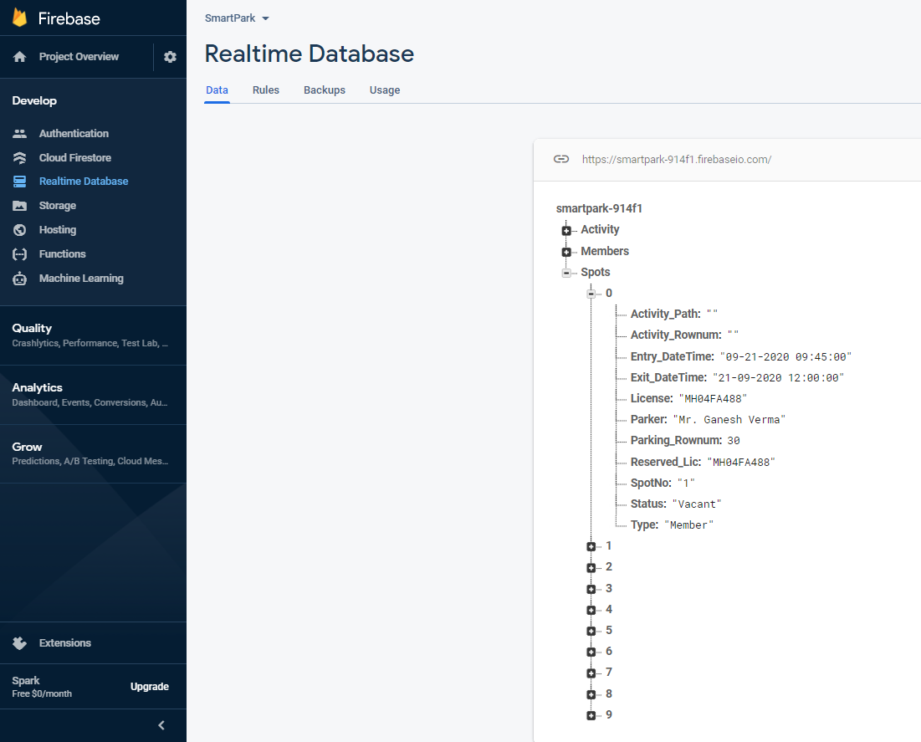
Database Output

Slide 25
FUTURE SCOPE
In future the system can be extended which is not only specific to a private parking like malls, company parking, etc.
It can also be implemented on public parking which has extending features such as reduction of traffic as search time for parking is reduced ,enhanced user experience as user can easily find the vacant parking lot, real-time data which is achieved by studying the arrival and leaving time of a particular car using ML,
Decreased management costs as this reduces the labour cost and can be more efficient.
Since data stored is real-time safety can be ensured which helps prevent parking violations and suspicious activity.

Slide 26
CONCLUSION
The first approach of using existing surveillance cameras for detecting license plates is presented.
An open source platform is used and improved to evaluate only objects that are moving.
The algorithm run on a distributed platform that operate multiple cameras and sensors, to support comprehensive security management.
The final output of the license plates was found to be very close to the actual value on the plates.

Slide 27
REFERENCES

Slide 28
Q&A and Feedback

Slide 29
Thank you

